Slide 1
Chapter 16: Disk Storage, Basic File Structures, Hashing, and Modern Storage Architectures
Notes:
We present the modeling concepts of the entity-relationship (ER) model, which is a popular high-level conceptual data model.
We describe the basic data-structuring concepts and constraints of the ER model and discuss their use in the design of conceptual schemas for database applications

Slide 2
Miniworld
A simplified overview of the database design process
Requirements Collection and Analysis
Data Requirements
High-level conceptual data model used
Conceptual Design
This is where E/R fits in
Conceptual Schema
(In a high-level data model)
DBMS-independent
Logical Design
(Data modeling mapping)
Implementation data model used
DBMS-specific
Logical (Conceptual) Schema
(In he data model of a specific DBMS)
Physical Design
Internal Design
Notes:
The last step is the physical design phase, during which the internal storage structures, file organizations, indexes, access paths, and physical design parameters for the database files are specified

Slide 3
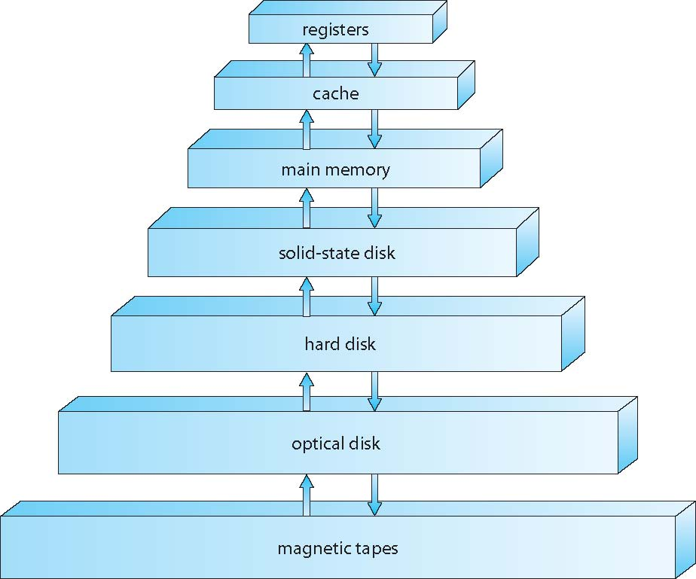
Introduction
Data in database must be stored physically on computer storage medium
The database software can then retrieve, update, and process this data as needed
Storage systems organized in hierarchy
Speed
Cost
Size
Volatility
Notes:
The main differences among the various storage systems lie in speed, cost, size, and volatility /,vɒlə'tɪlətɪ/
The design of a complete memory system mush balance all the factors just discussed
%%%%%%%%%%%%%%%%
The wide variety of storage systems can be organized in a hierarchy according to speed and cost
The higher levels are expensive, but they are fast;
As we move down the hierarchy, the cost per bit generally decreases, whereas the access time generally increases
Tradeoff
In addition to differing in speed and cost, the various storage systems are either volatile or non-volatile
As mentioned earlier, volatile storage loses its contents when the power to the device is removed. In the absence of expensive battery, data must be written to non-volatile storage for safe-keeping
In the hierarchy, the storage systems above the solid-state disk are volatile, whereas those including the solid-state disk and below are non-volatile

Slide 4
Introduction (cont.)
DBMS stores data on magnetic disks
This has major implications for DBMS design!
Read: transfer data from disk to main memory (RAM).
Write: transfer data from main memory to disk
Both are high-cost operations, relative to in-memory operations, so must be planned carefully!

Slide 5
Introduction (cont.)
Why not store everything in main memory?
Costs too much
Main memory is volatile
Typical storage hierarchy:
Main memory (RAM) for currently used data.
Disk for the main database.
Tapes for archiving older versions of the data.

Slide 6
Magnetic Disks
Magnetic disks provide bulk of secondary storage of modern computers
Each disk platter has a flat circular shape, like a CD
We store information by recording it magnetically on the platters
A read–write head “flies” just above each surface of every platter
The surface of a platter is logically divided into circular tracks, which are subdivided into sectors. The set of tracks that are at one arm position makes up a cylinder.
Notes:
In this section, we present a general overview of the physical structure of hard disk
The two surfaces of a platter are covered with a magnetic material
The heads are attached to a disk arm that moves all the heads as a unit.

Slide 7
Magnetic Disks (cont.)
Platters are 2-sided and magnetic
Platters rotates (about 10000 RPM)
All disk heads move at the same time (in or out)
Notes:
In this section, we present a general overview of the physical structure of hard disk
The two surfaces of a platter are covered with a magnetic material
The heads are attached to a disk arm that moves all the heads as a unit.

Slide 8
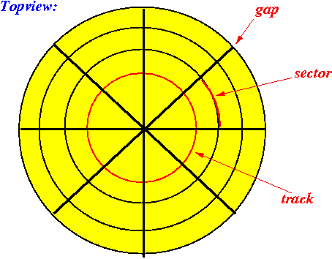

Magnetic Disks (cont.)
Tope view of a platter:
Platter has circular tracks
Tracks are divided into sectors
Sector = the unit of write operation for a disk
However
Gaps are non-magnetic and used to identify the start of a sector

Slide 9
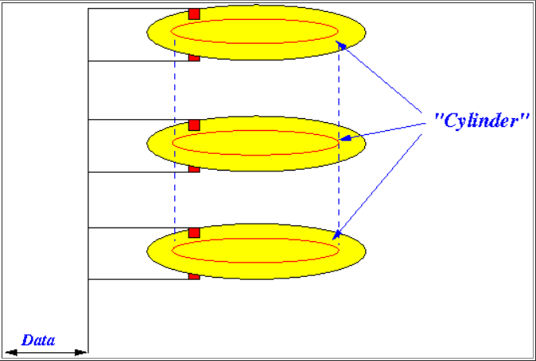
Magnetic Disks (cont.)
Cylinder = all tracks at the same distance from the center
Disk head does not need to move when accessing (read/write) data in the same cylinder

Slide 10
Average Access Time on Magnetic Disks
When the disk is in use, a drive motor spins it at high speed
Disk speed has two parts
Transfer rate is rate at which data flow between drive and computer
Positioning time (random-access time)
Seek time is the time for the disk arm to move the heads to the cylinder containing the desired sector
Rotational latency is the additional time for the disk to rotate the desired sector to the disk head

Slide 11
Average Access Time on Magnetic Disks
Positioning time = seek time + rotational latency
For fastest disk 3ms + 2ms = 5ms
For slow disk 9ms + 5.56ms = 14.56ms
Average I/O time = Positioning time + (amount to transfer / transfer rate) + controller overhead

Slide 12
A Running Example
Example: to transfer a 4KB block on a 7200 RPM disk with a 5ms average seek time, 1Gb/sec transfer rate with 0.1ms controller overhead
Average I/O time = 5ms + 4.17ms + 0.1ms + transfer time
Transfer time =
Average I/O time for 4KB block = 9.27ms + .031ms = 9.301ms

Slide 13
Making Data Access More Efficient on Disk
How to access data on hard disk efficiently?
This means having a fast access time (Positioning time) and large disk bandwidth
Minimize seek time
Seek time ≈ seek distance
Disk bandwidth is the total number of bytes transferred, divided by the total time between the first request for service and the completion of the last transfer

Slide 14
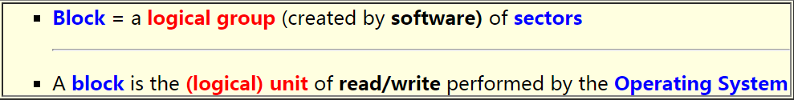
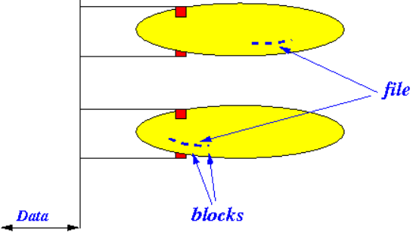
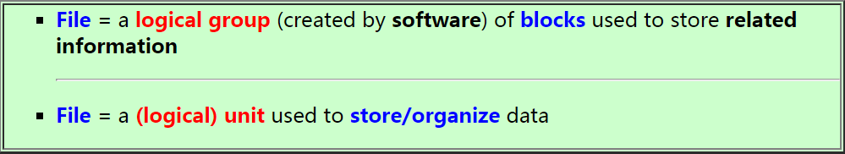
Concept of Block and File
Block:
File:

Slide 15
Introduction to Buffering
Chapter 3
Consider the following case:
Fact 1: main memory space is far smaller than disk space
Fact 2: main memory access speed is far larger than disk access speed
Issue: Several blocks need to be transferred from disk to main memory
Solution:
Several buffers can be reserved in main memory to speed the transfer
One type: Single Buffer
One type: Double Buffer
See the following formulation

Slide 16
Single Buffer
Chapter 3
Problem: have a file
Sequence of Blocks: B1, B2, …….
Have a program: » Process B1
» Process B2
» Process B3……
Single buffer solution:
(1) Read B1 → Buffer
(2) Process data in Buffer
(3) Read B2 → Buffer
(4) Process Data in Buffer…
Say
P = time to process 1 block
R = time to read in 1 block
n = # of blocks
What’s the total time for n blocks?
Single buffer time = n(P+R)

Slide 17
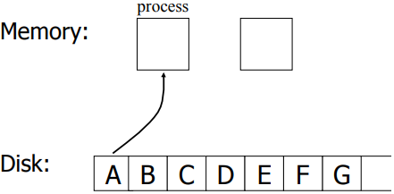
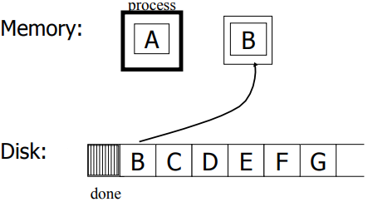
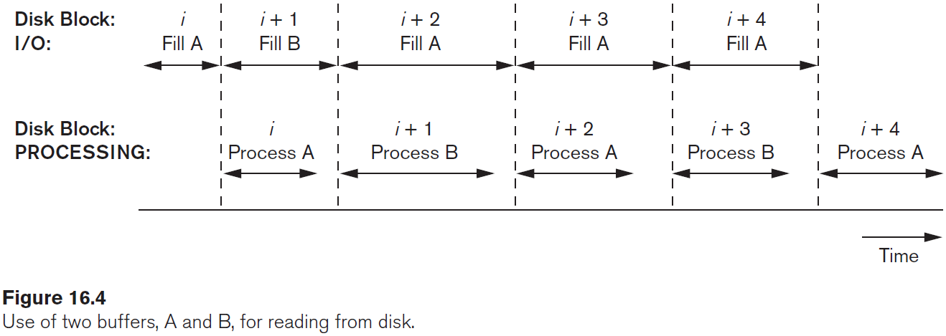
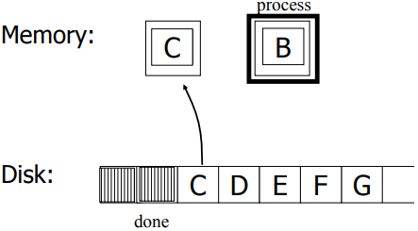
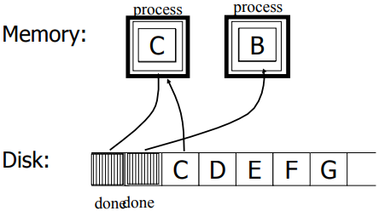
Double Buffer
Chapter 3

Slide 18
Double Buffer (cont.)
Chapter 3
Say:
P <= R
P = processing time for 1 block
R = I/O time for 1 bock
n = # of blocks
What ‘s the total time for n blocks?
Double buffering time = R + nP
Single buffering time = n (R + P)

Slide 19
Buffer Manager
DB Higher-Level Components (E.g., Query Execution)
Higher-level components do not interact with Buffer Manager
Buffer Manager manages what blocks should be in memory and for how long
Any processing requires the data to be in main memory
Main memory
Buffer Manager
Storage Manager
Disk

Slide 20
Some Terminology
Array called “Buffer Pool”
Each entry is called “Frame”
Main Memory
Empty frame
Each entry in the Buffer Pool (Frame) can hold 1 disk block
A disk block in memory is usually called “memory page”
Buffer Manager Keeps track of:
Which frames are empty
Which disk page exists in which frame
Used frame (has a page)
Disk
Disk block
(Disk page)

Slide 21
Buffer Management in a DBMS
Page Requests from Higher Levels
BUFFER POOL
disk page
free frame
MAIN MEMORY
DISK
choice of frame dictated
by replacement policy
DB
1 2 3 4 5 6 7 8 9 10 11 12 13 14 15 16 … 999

Slide 22
When a page is requested…
A page is the unit of memory we request
If Page in the pool
Great no need to go to disk!
If not? Choose a frame to replace.
If there is a free frame, use it!
Terminology: We pin a page (means it’s in use)
If not? We need to choose a page to remove!
How DBMS makes choice is a replacement policy

Slide 23
Questions
Main Memory
How to efficiently find an empty frame?
Given a request for Block B1, how to efficiently find whether is exists of not? In which frame?
Empty frame
Used frame (has a page)
Naïve Solution
Scan the array with each request ➔ O(n)

Slide 24
Questions ➔ Project 1
Main Memory
How to efficiently find an empty frame?
Given a request for Block B1, how to efficiently find whether is exists of not? In which frame?
Empty frame
Used frame (has a page)
Better Solution (For Q1)
Keep a list of the empty frame# {1, 30, 50, …}
Better Solution (For Q1)
Keep a bitmap of the array size 111101001001…
0: Empty & 1: Used

Slide 25
Questions ➔ Project 1
Main Memory
How to efficiently find an empty frame?
Given a request for Block B1, how to efficiently find whether is exists of not? In which frame?
Empty frame
Used frame (has a page)
Keep a hash table, given block Id (e.g., B1) ➔ Returns the frame # (if exists)
Better Solution (For Q2)

Slide 26
Requesting A Disk Page
I need page 3
Higher level DBMS
component
Buf Mgr
BUFFER POOL
MAIN MEMORY
22
disk page
3
I need page 3
3
free frames
Disk Mgr
DISK
1
2
3
…
22
…
90
If requests can be predicted (e.g., sequential scans) pages can be pre-fetched several pages at a time!

Slide 27
Pin A Memory Page
Pin this page
Can be a flag (T & F)
Can be a counter (0 = unpinned)
Pinning a page means not to take from the memory until un-pinned
Why to pin a page
Keep it until the transaction completes
Page is important (referenced a lot)
Recovery & Concurrency control (they enforce certain order)

Slide 28
Releasing Unmodified Page
I read page 3 and I’m done with it
Higher level DBMS
component
Buf Mgr
BUFFER POOL
MAIN MEMORY
22
disk page
3
free frames
Unpin the page (if you can)
since page is not modified ➔ Just claim this frame# in free list
No need to write back to disk

Slide 29
Releasing Modified page
I wrote on page 3 and I’m done with it
Higher level DBMS
component
MAIN MEMORY
Buf Mgr
BUFFER POOL
22
disk page
3’
3’
free frames
Disk Mgr
DISK
1
2
3’
3
…
22
…
90

Slide 30
More on Buffer Management
Meta Data Information: <frame#, disk-pageid, pin_count, dirty>
Requestor of page must eventually unpin it, and indicate whether page has been modified:
dirty bit is used for this.
Page in pool may be requested many times,
a pin count is used.
To pin a page, pin_count++
A page is a candidate for replacement iff pin count == 0 (“unpinned”)

Slide 31
What if the buffer pool is full? ...
If requested page is not in pool:
Choose a frame for replacement.
Only “un-pinned” pages are candidates!
If frame is “dirty”, write it to disk
Read requested page into chosen frame
Pin the page and return its address.

Slide 32
Buffer Replacement Policy
Frame is chosen for replacement by a replacement policy:
Least-recently-used (LRU)
First-in-First-Out (FIFO),
……

Slide 33
LRU Replacement Policy
Least Recently Used (LRU)
for each page in buffer pool, keep track of time when last accessed
replace the frame which has the oldest (earliest) time
very common policy: intuitive and simple
Works well for repeated accesses to popular pages

Slide 34
LRU causes sequential flooding in a sequential scan
I need page 1
I need page 2
I need page 3
I need page 4
Higher level DBMS
component
I need page 1
I need page 2…!!!
Buf Mgr
BUFFER POOL
1
4
2
1
3
Disk Mgr
MAIN MEMORY
DISK
1
2
3
4

Slide 35
Placing File Records on Disk
Chapter 3
Data is usually stored in the form of records
Records usually describe entities and their attributes
An EMPLOYEE record represents an employee entity
A file is a sequence of records
If every record in the file has exactly the same size (in bytes), the file is made up of fixed-length records
If different records in the file have different sizes, the file is made up of variable-length records

Slide 36
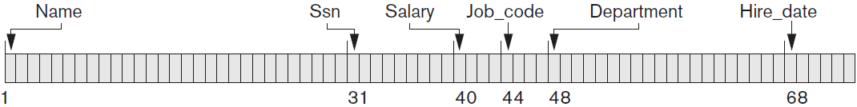
Fixed-length Record
The fixed-length employee records
Record size: 71
Every record has the same fields, and field lengths are fixed
The systems can identify the starting byte position of each filed
This facilitates locating field values by programs that access such files
Bad property: finding i’th field requires scan of record

Slide 37
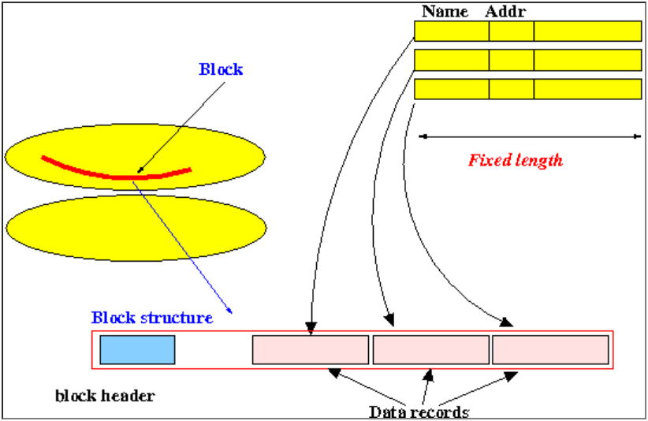
Storing Fixed-length Records on a Disk Block
Fact:
Records are stored in (disk) blocks
Note: this is also true for variable length records

Slide 38
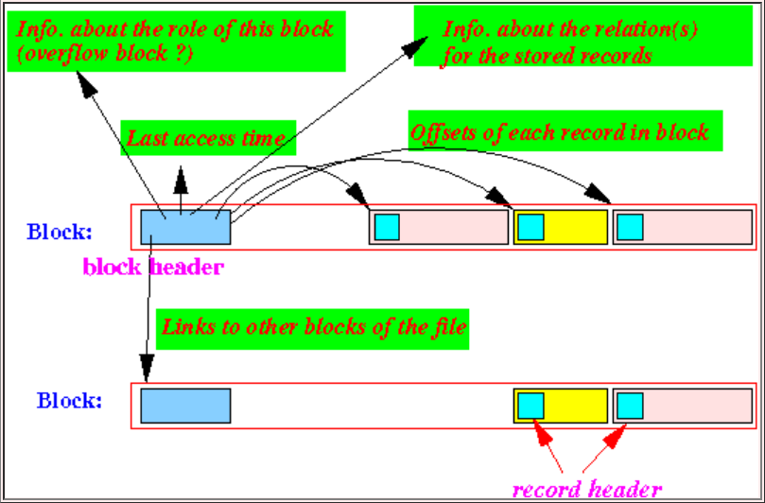
Storing Fixed-length Records on a Disk Block (cont.)
Each block has a block header:
With information on the records stored in the block

Slide 39
What’s the Role of File
The records of a file must be allocated to disk blocks
Block is the unit of data transfer between disk and memory
A file consists of one or more blocks
So a file is the user accessible object that contains the records

Slide 40
Spanned and Unspanned Record Storage
How about the following case:
Block size: B
Record size: R (B ≥ R)
We can fit records per block.
Unused space: B - bfr*R

Slide 41
Spanned and Unspanned Record Storage (cont.)
How to use this unused small space?
Can store part of a record on one block and the rest on another
A pointer at the end of the first block points to the block containing the remainder of the record
Why need a pointer?
Called Spanned organization:
A record can span more than one block
Unspanned organization: a record does not span over multiple blocks

Slide 42
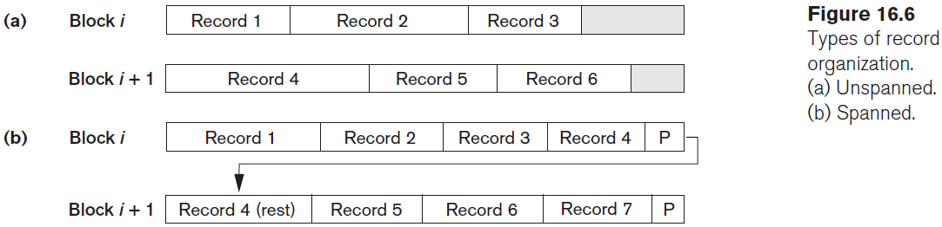
Spanned v.s. Unspanned (Example)

Slide 43
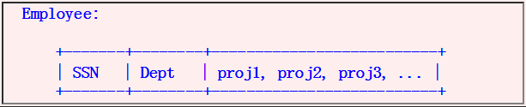
Variable-length Record
Situations where record size is variable
Case 1: Record contains a String typed attribute
Case 2: Record contains a repeating field
Example: employee working on multiple projects

Slide 44
Storing Variable-length Record on Disk Block
We do not know the exact length of some field values
To determine the bytes that represent each field, we can use special separator character
Such as ? or % or $
Which do not appear in any field value
See example in next slide:

Slide 45
Storing Variable-length Record on Disk Block (Example)
To determine the bytes that represent each field, we can use special separator character
Such as ? or % or $
F1
F2
F3
F4
4
$
$
$
$
Field count
Fields delimited by special symbols

Slide 46
Storing Variable-length Record on Disk Block (Example) (cont.)
Another method
Store the starting position of each field in the record, preceding the field values
Array of field offsets
F1
F2
F3
F4
4
7
12
16

Slide 47
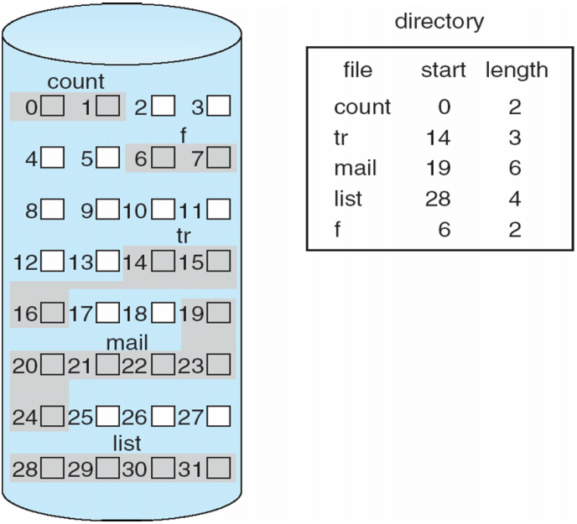
Allocating File Blocks on Disk
Several standard techniques:
Contiguous allocation
Files blocks are allocated to consecutive disk blocks
Make reading the whole file very fast
Makes expanding the file difficult

Slide 48
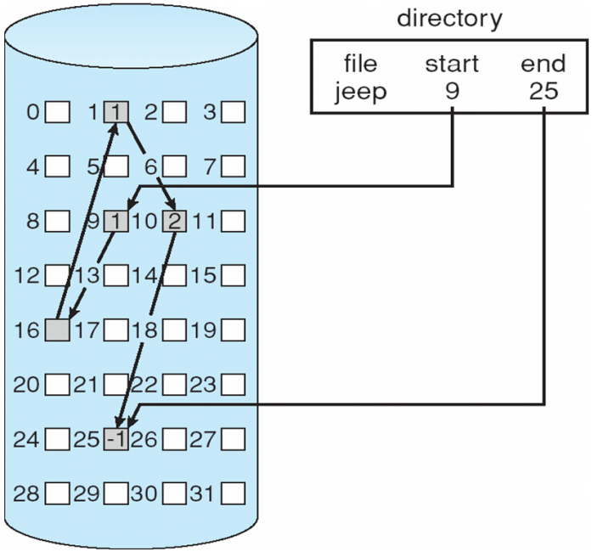
Allocating File Blocks on Disk
Several standard techniques:
Linked allocation
Each file block contains a pointer to the next file block
Makes it easy to expand the file
Makes it slow to read the whole file

Slide 49
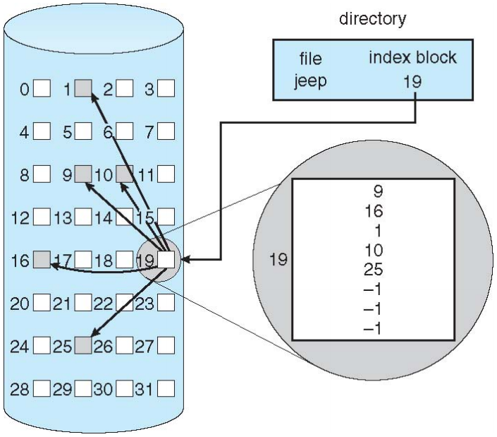
Allocating File Blocks on Disk (cont.)
A combination of the two:
Allocates clusters of consecutive disk blocks, and the clusters are linked
Indexed allocation
One of more index blocks contain pointers to the actual file blocks

Slide 50
File Organization
File Organization means the physical arrangement of data in a file into records and pages on secondary storage:
Heap files
Sorted files
Hashed files

Slide 51
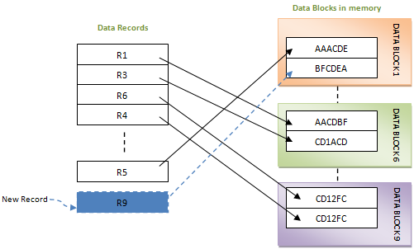
Heap Files
Simplest file structure:
Records are placed in the file in the order in which they are inserted
New records are inserted at the end of the file
files of unordered records.

Slide 52
Heap Files (cont.)
Quick insertion (no particular ordering):
When a new record is created, it is put in the last block of the file if there is sufficient space
Otherwise, a new block is added to the file
Slow retrieval (only allow linear search)
Reading blocks from the file until a required record is found
To delete a record, the record is marked as deleted. Space is reclaimed during periodical reorganization

Slide 53
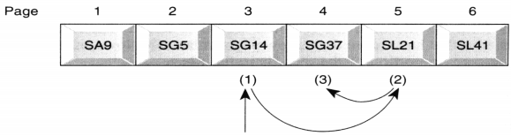
Ordered Files
Ordered Files: Records are sorted on field(s) => Key
Allow Binary Searching (See an example):
Suppose one page stores one record.
To search for SG37, search the middle page (6/2 = 3) first
We find that SG37 does not exist in this page(SG14).
Then, since SG37 is greater than SG14, we search the middle page within the lower half of the file, and so on

Slide 54
Ordered Files (cont.)
Inserting a record
If the appropriate page is full, may have to reorganize the whole file => Time consuming
Solution: use a temporary unsorted file (transaction file). Merge to the sorted file periodically.
Rarely used unless come with an index => Indexed Sequential File
Both Heap Files and Ordered Files are also called Sequential Files

